Slide 1



Data Science
Workshop
A guide by Houda Bakir
houda.bakir@datavora.com
Notes:
Me , a year , opportunité de travailler dessus

Slide 2



DATA PREPARATION
Data Science Pipeline
Tools to use
Numpy
Scipy
Pandas
matplotlib
Notes:
Commencez avec Presentation de Datavora ,
Introduction de ML
C’est quoi machine learning Machine learning CLasses

Slide 3
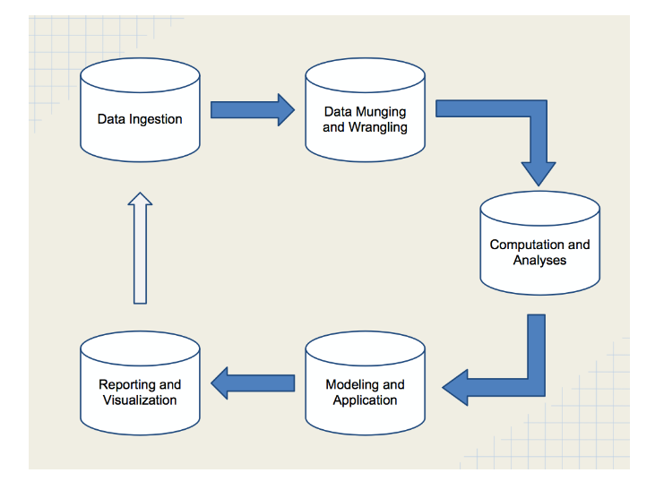
The following diagram shows the data science pipeline:
Data munging or wrangling 80 % or more of project time and resources
Notes:
In this study we used european phone market as you can see we can follow the evolution of prices in different online market. Amazon.it, Amazon.de , Amazon.de and Amazon.fr .
You can see the number of datapoints in one week 6 millions and 5 eighty seven thousand And 8 handred and 3
The values here are prices every 12 hours .
- The purpose of this study was to try to predict the future price of phones in particular the price of

Slide 4

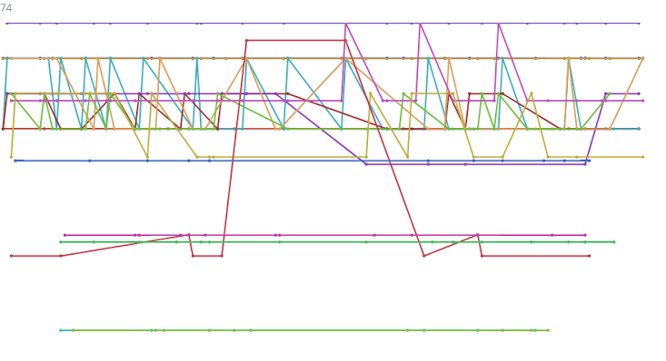

Reebok Classic Leather Purple
$90.80
http://www.ebay.co.uk/itm/Reebok-Classic-Leather-Womens-Suede-Purple-Red-Trainers-New-Shoes-All-Sizes-/381019249763
Notes:
Types de données c’est textuelle, images , et numérique comme les prix
On peut voir évolution du prix sur plusieurs sites marchants

Slide 5
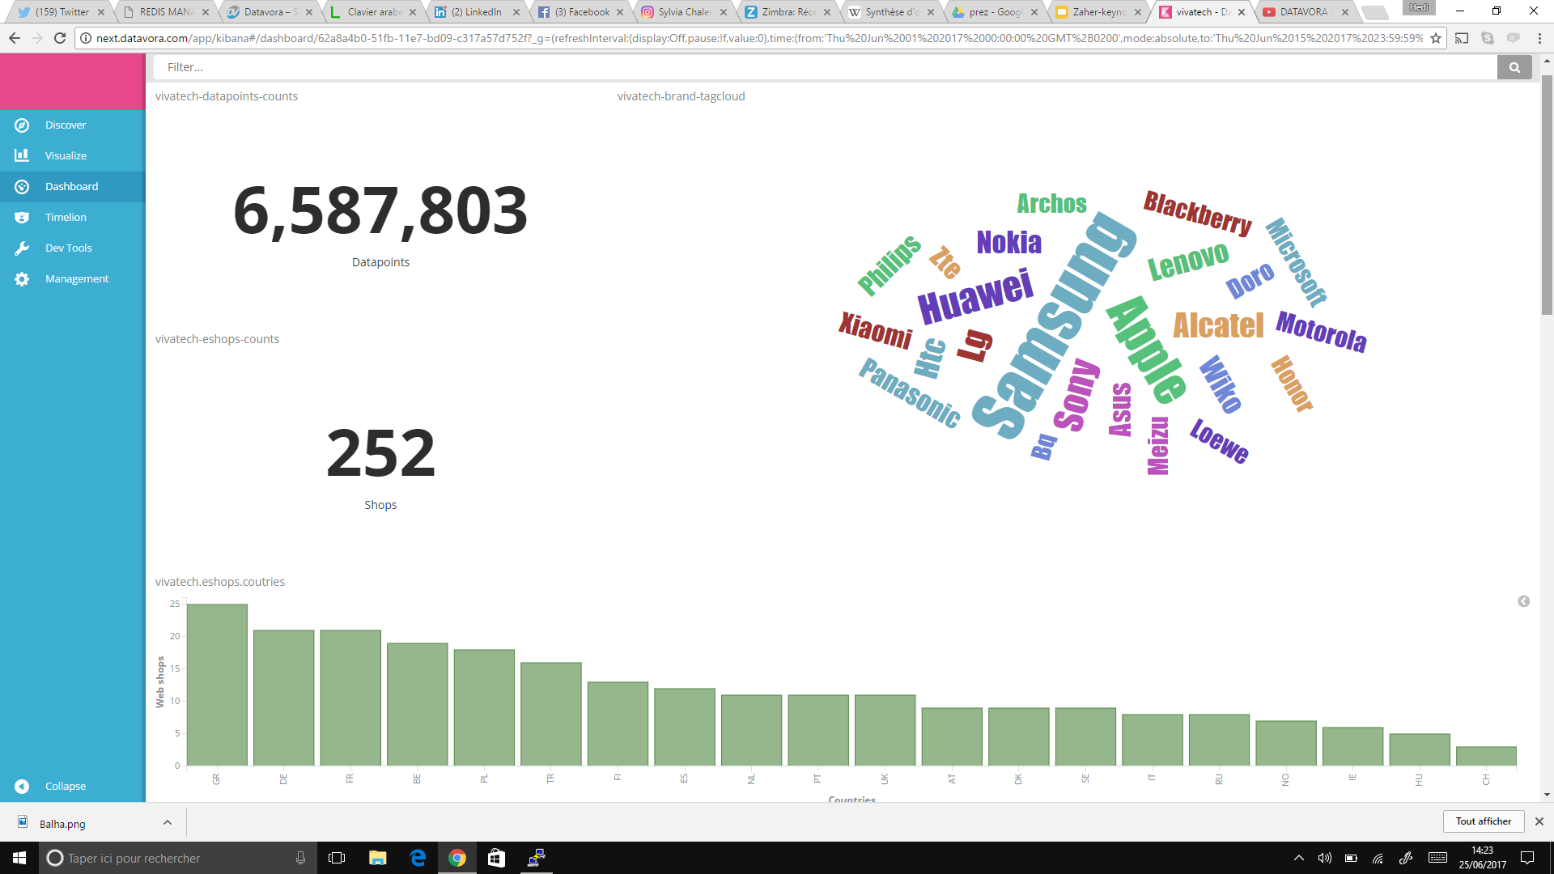
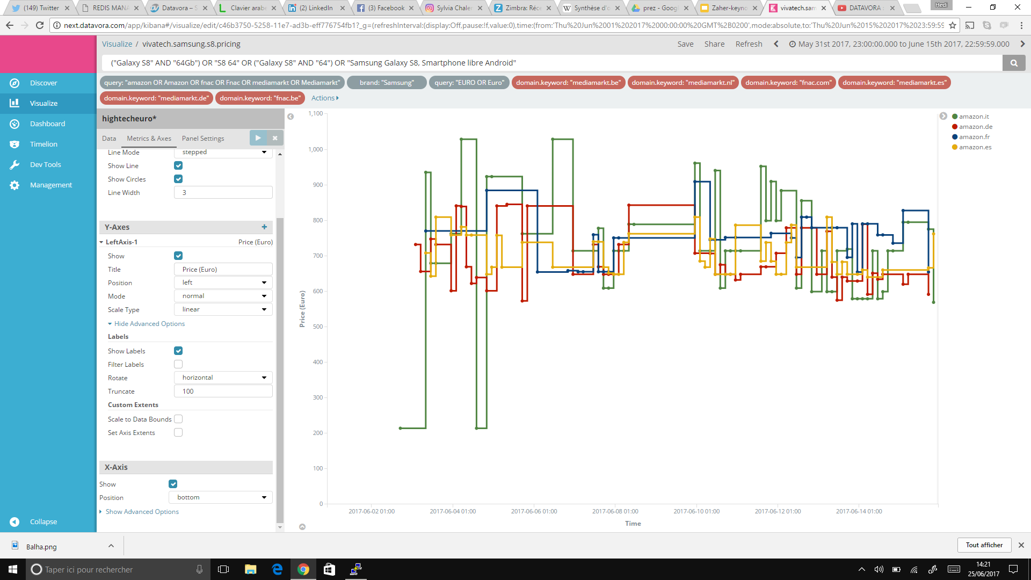
Notes:
Nous offrons à nos clients les data brute ou en visualisation comme ici ces des exemples de dashboard
Un autre exemple avec les téléphones portables on peut voir la présence de telle ou telle téléphones
Ces données c l’évolution des prix sur amazon it ,de , fr et es
Du samsung galaxy S7 edge 32 GB
Pour détecter un certain produit des fois sur les sites on a plusieurs paramètre qui entre en jeu :
Language - l’ordre des mots on utilise la mahine learning pour réaliser ce product matching

Slide 6
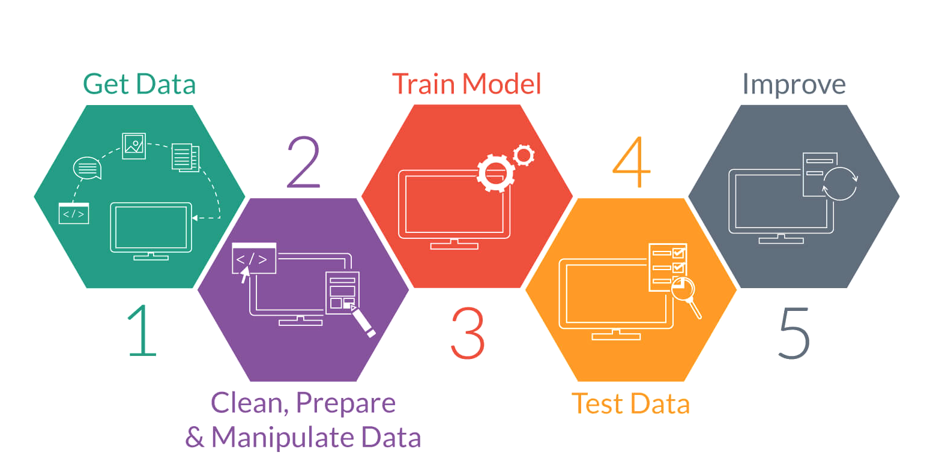
Steps of Machine Learning

Slide 7
Tools to use
NumPy is the foundational library for scientific computing in Python, and many of the libraries on this list use NumPy arrays as their basic inputs and outputs.
SciPy builds on NumPy by adding a collection of algorithms and high-level commands for manipulating and visualizing data. (Functions for computing integrals numerically, solving differential equations, optimization, and more.)
Pandas adds data structures and tools that are designed for practical data analysis in finance, statistics, social sciences, and engineering. Pandas works well with incomplete, messy, and unlabeled data (i.e., data in the real world), and provides tools for shaping, merging, reshaping, and slicing datasets.
matplotlib is the standard Python library for creating 2D plots and graphs. It’s low-level, meaning it requires more commands to generate nice-looking graphs and figures than with some more advanced libraries.
sudo apt-get install python3-numpy python3-scipy python3-matplotlib python3-pandas

Slide 8

Numpy
NumPy is at the core of nearly every scientific Python application or module since it provides a fast N-d array datatype that can be manipulated in a vectorized form.

Slide 9
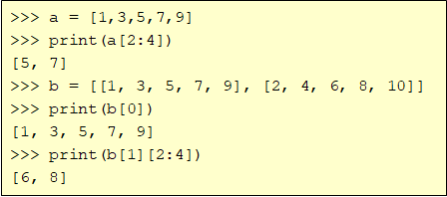
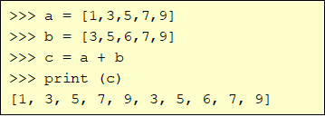


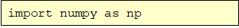
Arrays – Numerical Python (Numpy)
Lists are good for small amounts on one-dimensional data and can’t use arithmetic operators (+, -, *, /, …).
Install Numpy
Import Numpy

Slide 10
Numpy – Creating arrays
There are a number of ways to initialize new numpy arrays
– a Python list or tuples
– using functions that generate numpy arrays : arange, linspace, etc.
– reading data from files : “.csv” , “. json” , etc.
Install Numpy
Import Numpy

Slide 11
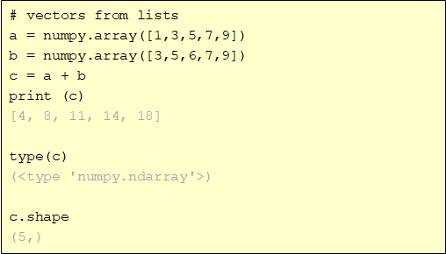
Numpy – Creating vectors
From Lists
numpy.array

Slide 12
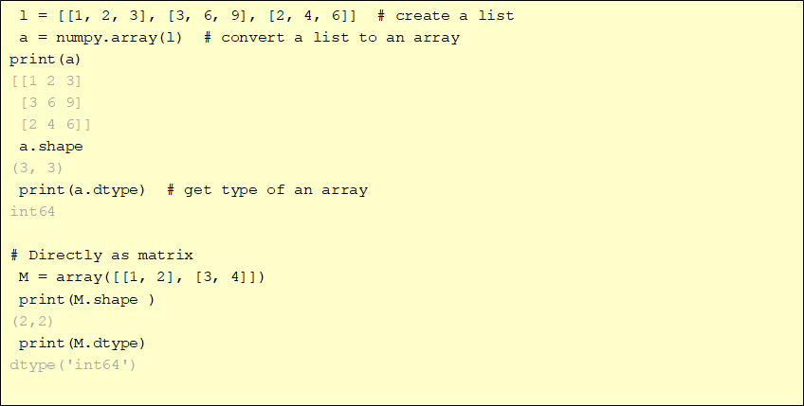
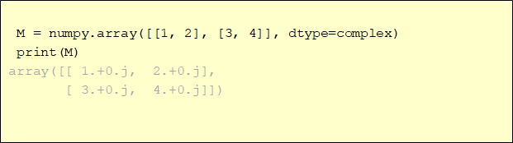
Numpy – Creating matrices
From Lists
numpy.array

Slide 13
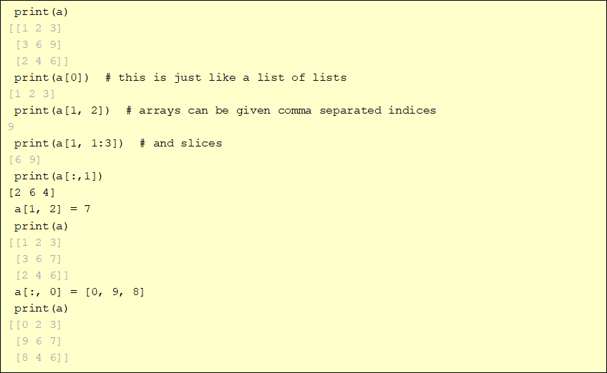
Numpy – Matrices use

Slide 14
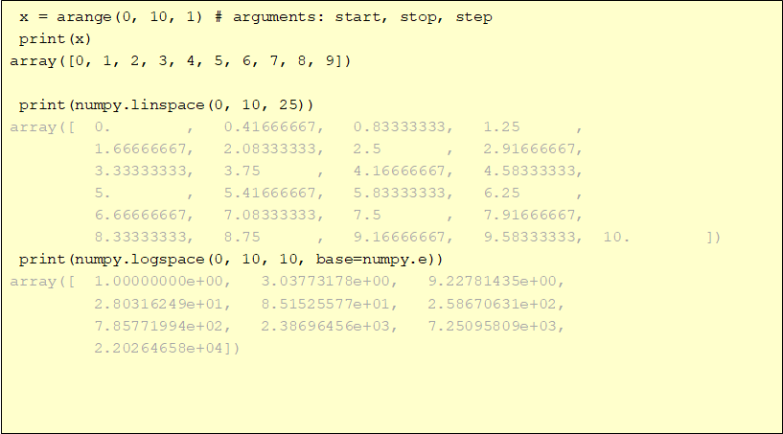
Numpy – Creating arrays

Slide 15
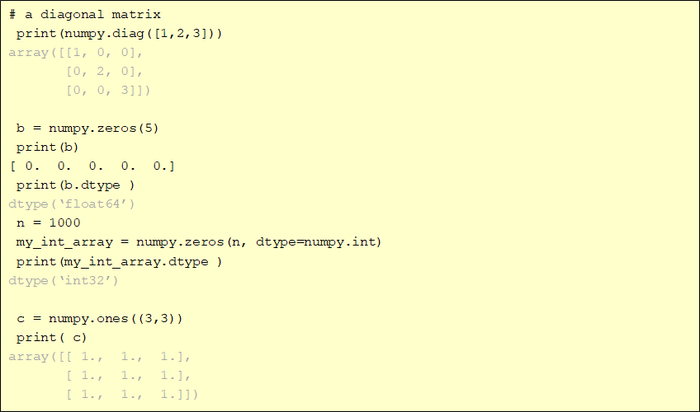
Numpy – Creating arrays

Slide 16
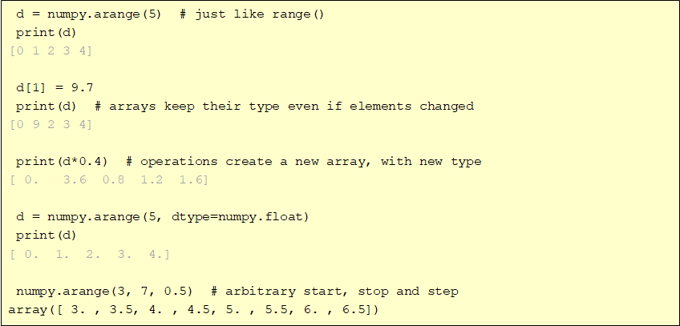
Numpy – array creation and use

Slide 17
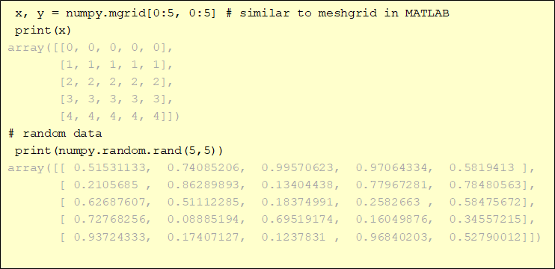
Numpy – array creation and use

Slide 18
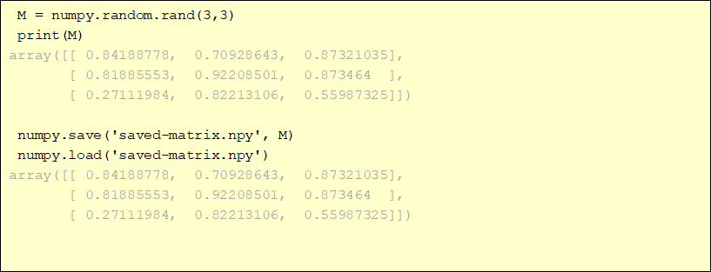
Numpy – array creation and use
NumPy's main object is the homogeneous multidimensional array called ndarray.

Slide 19
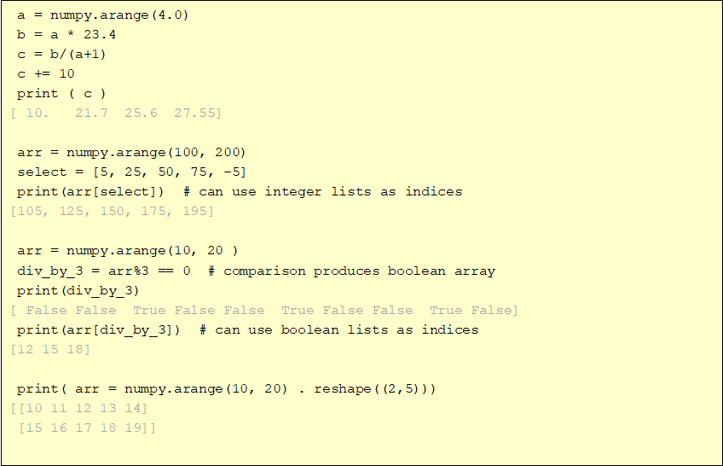

Slide 20
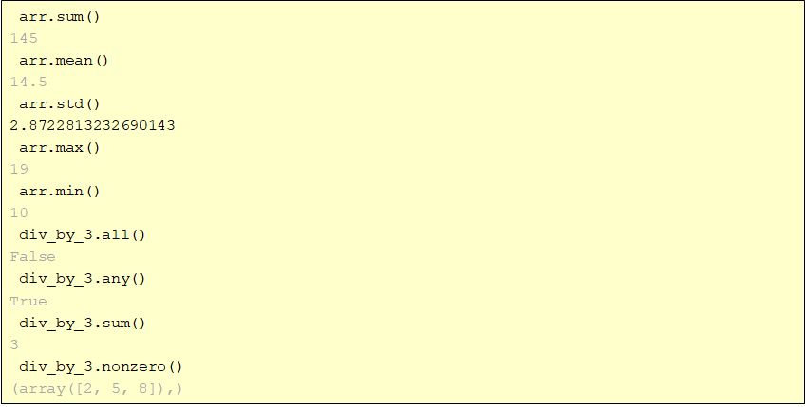
Numpy – array methods

Slide 21
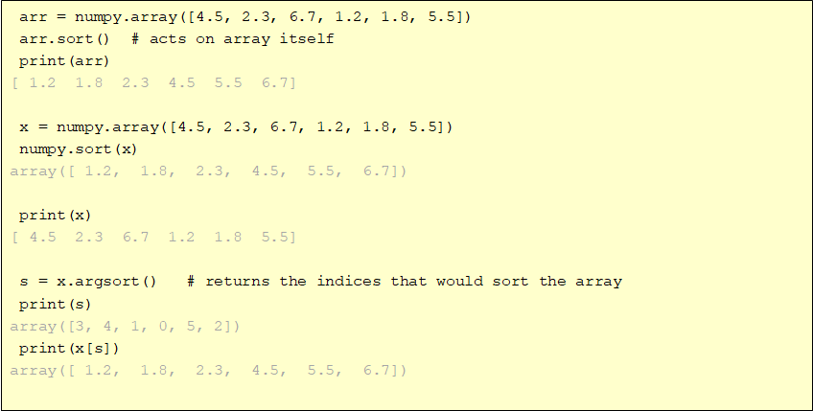
Numpy – array methods - sorting

Slide 22
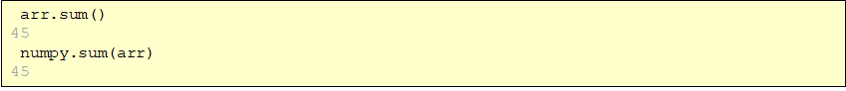
Numpy – array functions
Most array methods have equivalent functions
provide many element-by-element math, trig., etc. operations
e.g., add(x1, x2), absolute(x), log10(x), sin(x), logical_and(x1, x2)

Slide 23
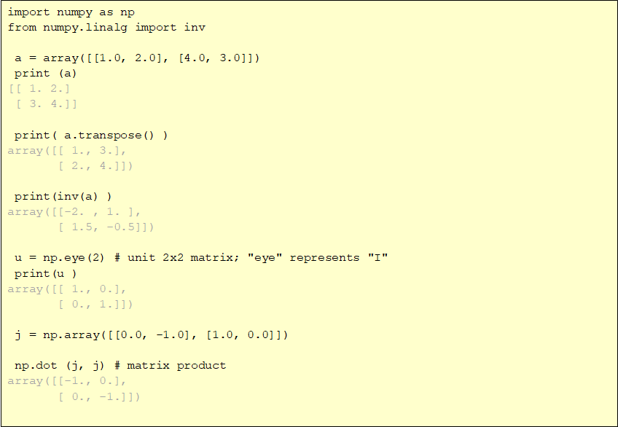
Numpy – array operations

Slide 24
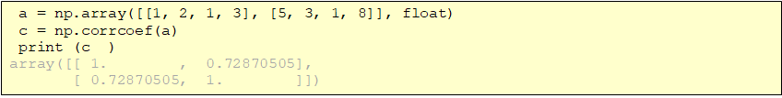
Numpy – statistics
In addition to the mean, var, and std functions, NumPy supplies several other methods for returning statistical features of arrays. The median can be found:
The correlation coefficient for multiple variables observed at multiple instances can be found for arrays of the form [[x1, x2, …], [y1, y2, …], [z1, z2, …], …] where x, y, z are different observables and the numbers indicate the observation times:
The covariance for data can be found:

Slide 25
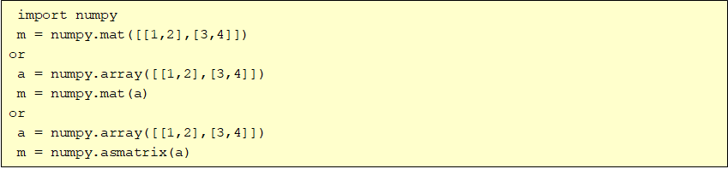
Numpy – arrays, matrices
For two dimensional arrays NumPy defined a special matrix class in module matrix. Objects are created either with matrix() or mat() or converted from an array with method asmatrix().

Slide 26
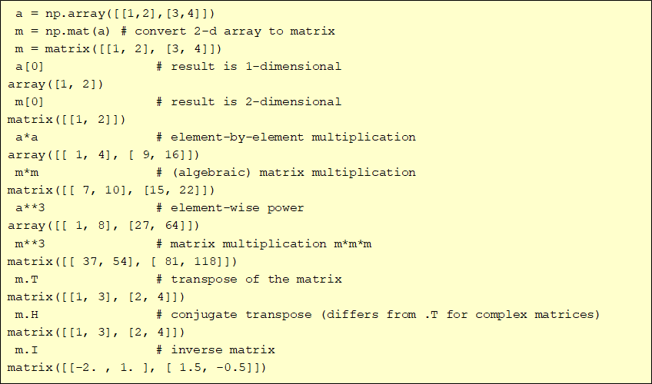
Numpy – matrices

Slide 27
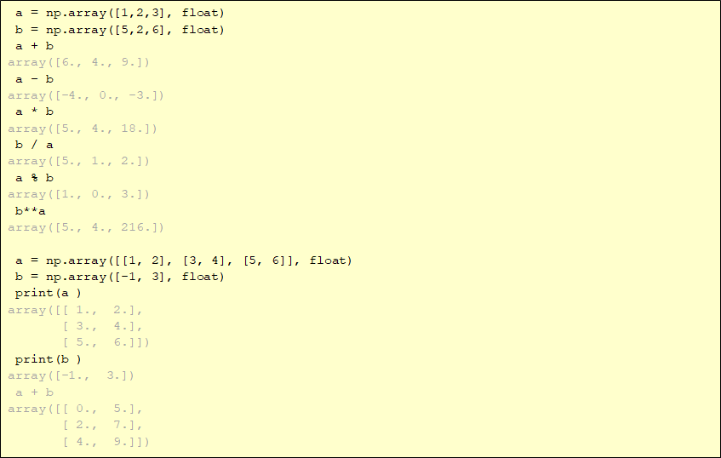
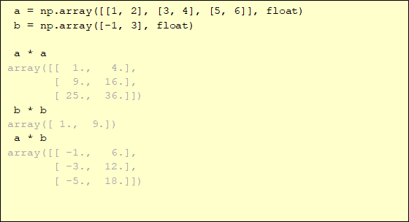
Numpy – array mathematics

Slide 28

SciPy
SciPy is an Open Source library of scientific tools for Python. It depends on the NumPy library, and it gathers a variety of high level science and engineering modules together as a single package. SciPy provides modules for:
file input/output, statistics, optimization, numerical integration, linear algebra, Fourier transforms, signal processing, image processing, ODE solvers and special functions.

Slide 29
SciPy: Statistics scipy.stats
The main public methods for continuous Random Variables are:
rvs: Random Variates
pdf: Probability Density Function
cdf: Cumulative Distribution Function
sf: Survival Function (1-CDF)
ppf: Percent Point Function (Inverse of CDF)
isf: Inverse Survival Function (Inverse of SF)
stats: Return mean, variance, (Fisher’s) skew, or (Fisher’s) kurtosis
moment: non-central moments of the distribution

Slide 30
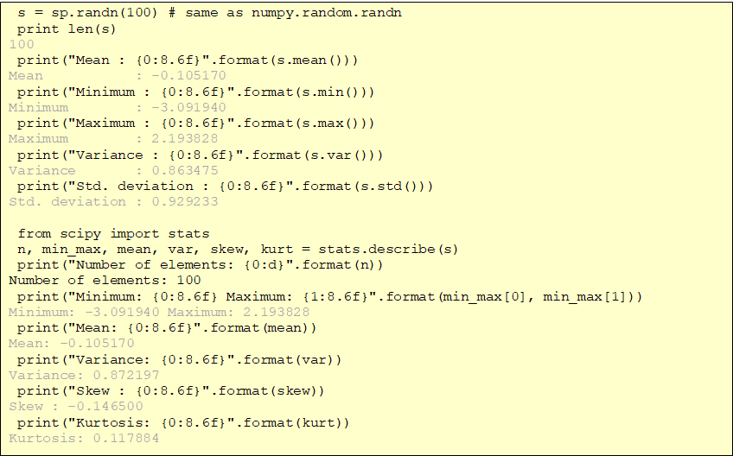

Slide 31
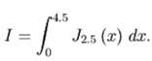
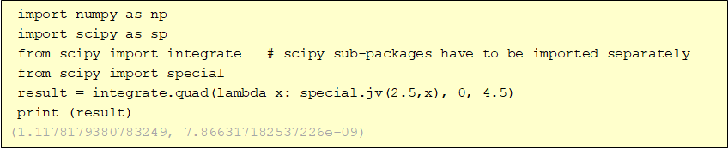
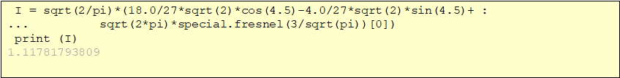
Example: Numerical integration
•Integrate a Bessel function jv(2.5,x) from 0 to 4.5:

Slide 32
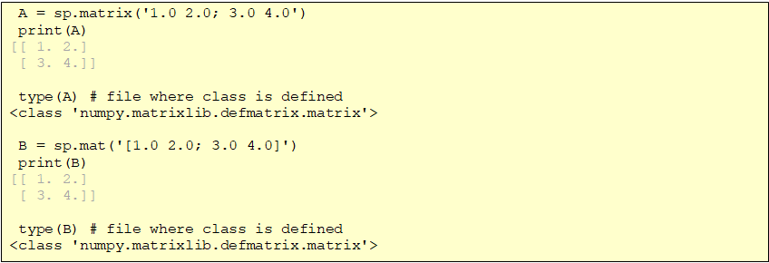
SciPy: Linear Algebra

Slide 33
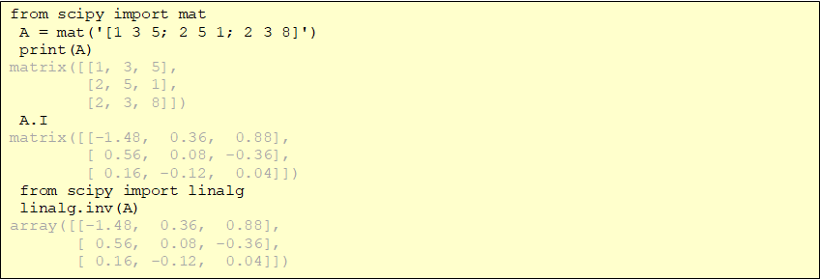
SciPy: Linear Algebra

Slide 34
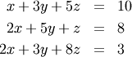
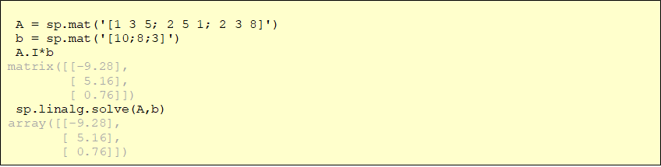
SciPy: Linear Algebra
Solving linear system
S = A⁻¹ B where S=[ x y z] and B = [ 10 8 3]

Slide 35
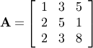
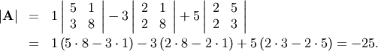
SciPy: Linear Algebra
Finding Determinant

Slide 36
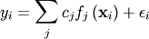
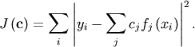
SciPy: Linear Algebra
Solving linear least-squares problems
The model
Minimize
After some algebra, vector/matrix representations of this problem
As an example solve for model:

Slide 37
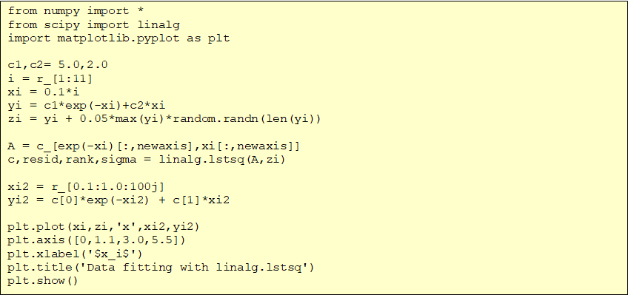
SciPy: Linear Algebra

Slide 38
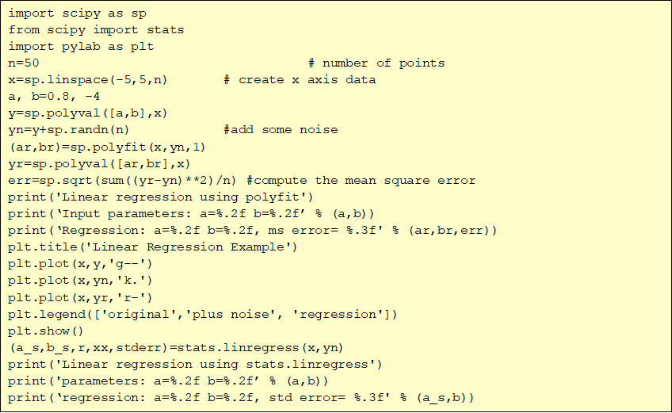
Example: Linear regression

Slide 39
Travaux Pratique
Exercice 1
Exercice 2
Exercise 3

Slide 40
THANK YOU
Send your CV :
houda.bakir@datavora.com

